Slide 1
Multi-scale Forest Fire Prediction Using Deep Learning
Sayak Das (RA2011026010101)
Roopal Sood (RA2011026010103)
Under the guidance of - Dr.M.S.Abirami
(Associate Professor)

Slide 2
Abstract
Forest fires pose a significant threat to ecosystems,wildlife, human lives, and property. Timely and accurate prediction of forest fires is crucial for effective fire management and prevention. In this study, we propose a deep learning-based approach for forest fire prediction. Our method leverages historical weather data, satellite imagery, and other relevant environmental factors to predict the likelihood of a forest fire occurrence.
Results showcase its efficacy in early and accurate forest fire prediction, aiding proactive management and resource allocation. This approach holds the potential to reduce the environmental and human toll of forest fires, serving as a crucial tool for decision-makers and emergency responders.

Slide 3
Introduction
Forest fires are a recurring natural disaster with significant ecological, environmental, and socio-economic implications. Timely and accurate prediction of forest fires plays a pivotal role in minimizing their destructive impact. In recent years, advancements in deep learning techniques have opened new avenues for enhancing prediction accuracy by harnessing the power of complex data analysis and pattern recognition.
This study focuses on the application of deep learning methodologies to predict forest fires. By integrating diverse data sources such as historical weather data, satellite imagery, and terrain characteristics, deep learning models can effectively capture spatial and temporal patterns associated with fire occurrences. The proposed deep learning model employs a convolutional neural network (CNN) to analyze satellite images and capture spatial patterns indicative of potential fire risk.

Slide 4
Motivation
The motivation behind this project is to harness the potential of deep learning to revolutionize forest fire prediction. Deep learning's ability to analyze complex and diverse data sources, such as satellite imagery and historical weather data, presents an opportunity to uncover intricate patterns and correlations related to fire outbreaks.
By developing a sophisticated prediction model, this project seeks to empower stakeholders with more precise and actionable information, enabling proactive decision-making, resource allocation, and early warning systems.
Ultimately, the motivation for this project lies in its potential to significantly enhance forest fire prediction accuracy, thereby aiding in the preservation of invaluable natural resources, protection of human lives, and reduction of the socio-economic impact caused by these devastating wildfires.

Slide 5
Problem statement
Forest fires pose a severe and increasing threat to ecosystems, lives, and property. Traditional prediction methods are often simplistic, failing to account for the multi-scale factors influencing fire behavior. This project aims to develop an advanced multi-scale forest fire prediction system using deep learning. By considering spatial and temporal variations, it seeks to revolutionize fire prediction and empower authorities with the tools to respond proactively, ultimately mitigating the impact of forest fires on the environment, communities, and resources, thereby saving lives.

Slide 6
Objectives
Multi-Scale Prediction: Develop a predictive model that takes into account various spatial and temporal scales affecting forest fire behavior.
Spatial Analysis: Utilize Convolutional Neural Networks (CNNs) to process high-resolution images and remote sensing data, enabling the extraction of spatial features and patterns contributing to fire risk.
Temporal Modeling: Implement ANN and Long Short-Term Memory Networks (LSTMs) to capture temporal dependencies in meteorological variables, such as temperature, humidity, wind speed, and precipitation, at various time scales.
Interpretability: Implement interpretability techniques to make the model's predictions more transparent and understandable. Highlight the key factors contributing to the predictions, enhancing usability.

Slide 7
Research Gap / Limitations Identified
Sparse Data in Some Regions: The availability of comprehensive and up-to-date data is essential for accurate predictions. However, in some remote or less-monitored regions, data may be sparse or of lower quality. Addressing this data gap is crucial for ensuring the model's effectiveness across different geographic areas.
Data Integration Challenges: Integrating data from various sources, such as satellite imagery, meteorological data, and historical records, can be challenging due to differences in data formats, resolutions, and quality. Developing robust data integration methods is critical for creating a cohesive and reliable dataset.
Uncertainty Estimation: While the project aims to provide uncertainty estimates for predictions, accurately quantifying uncertainty in deep learning models remains a complex challenge. Research is needed to develop more precise methods for uncertainty quantification, particularly in the context of forest fire prediction.
Limited Historical Fire Data: The availability of historical fire incident data can be limited in some regions, especially for rare or infrequent events. This can affect the model's ability to learn from past incidents.

Slide 8
Innovation
This project introduces a groundbreaking approach to forest fire prediction by harnessing the capabilities of deep learning algorithms. The innovation lies in the integration of multiple advanced techniques to create a comprehensive and accurate prediction model.
Multi-modal Data Fusion
Continuous Learning and future prediction
Feature Engineering and Selection
Hybrid Spatial-Temporal Modeling
Scalability and worldwide impact

Slide 9
Scope
01
02
03
04
05
Data fusion & Integration
Scalability- real time monitoring
Alert & decision support system
Collaborative platforms
Climate change prediction using collected data

Slide 10
Datasets
CSV Files
https://www.kaggle.com/datasets/vikasukani/forest-firearea-datasets
https://www.kaggle.com/datasets/kartikeyshaurya/forest-fire-prediction-dataset
https://www.kaggle.com/datasets/soumya9977/forest-fire-prediction
Image Files
https://www.kaggle.com/datasets/mateus558/brazilian-legal-amazon-burned-area-dataset
https://www.kaggle.com/datasets/nchakradharreddy9/forest-fire-predictions

Slide 11
Literature Survey
S. no | Journal | Author | Title | Volume, Issue No, Year | Methodology | Inference
1. | IEEE, Xplore | 1) Naaman Omar 2)Adel Al-zebari 3) Abdulkadir Sengur | Deep Learning Approach to Predict Forest Fire using Meteorological Measurements. | 17 January 2022 | 1) AI based Approach. 2) LSTM | 1)Quickly identifying and controlling forest fires. 2)Various metrics are employed to evaluate the accuracy and performance of the proposed model.
2. | SpringerOpen | 1)Sathishkumar, 2)V.E., 3)Cho, 4)J. Subramanian | Forest fire and smoke detection using deep learning-based learning without forgetting | Article number: 9 (2023) | 1)Real-time Implementation 2)Enhancing Transfer Learning | 1)Use of AI-based CV techniques, particularly CNN, for fire and smoke detection from images. 2)It mentions that Xception performed the best with 79.23% accuracy.
3. | ResearchGate | 1) J Anathi 2) Kamal Upreti 3) S. Nallasamy | Forest fire prediction using IoT and deep learning | March 2022 | 1)The research involves the use of a smart forest monitoring kit (SFMK) as a key component. 2) The data collected includes weather parameters and smoke or gas levels. | 1)The research project centers on the development of an advanced forest fire prediction system. 2)The forest fire prediction system not only forecasts fire risks but also assesses its own performance through accuracy metrics.

Slide 12
4. | MDPI | 1)Xufeng 2)LinORCID 3)Zhongyuan Li 4)Wenjing Chen 5)Xueying Sun 6)Demin Gao | Forest Fire Prediction Based on Long- and Short-Term Time-Series Network | 10 April 2023 | 1) Highlight the global significance and hazards of forest fires. 2) Highlight the need to consider short-term and long-term recurring patterns in data, especially in the case of temperature. | 1) The study focuses on the choice of influential factors and variables related to forest fires, such as geographical and meteorological data. 2)The process of constructing the forest fire prediction model based on LSTNet and selected influential factors is explained.
5. | Canadian Science Publishing | 1)Piyush Jain 2)S.C.P.Soogan 3)S.G. Subramanian 4)Mark Crowley 5)Steve Taylor 6)M.D.Flannigan | A review of machine learning applications in wildfire science and management. | 28 July 2020 | 1)This scoping review assesses ML's applications in wildfire science across six domains. 2)Literature search methodology and results. | 1)The primary objective of the study is to enhance awareness of ML methods among wildfire researchers. 2)The text provides an overview of the research structure, outlining the key sections of the study.
6 | Scientific Research | 1)Prathibha Sobha 2)Shahram Latifi | A Survey of the Machine Learning Models for Forest Fire Prediction and Detection. | Vol.16 No.7, July 2023 | 1)The text discusses the various methods historically used for forest fire prediction, including statistical and machine learning approaches. 2) The LSTNet model is introduced as the primary tool for predicting forest fires. | 1)The research is situated in Chongli District, Hebei Province, China, with information provided about its geographical location and characteristics 2)The inclusion of an autoregressive model to improve predictions is highlighted..

Slide 13
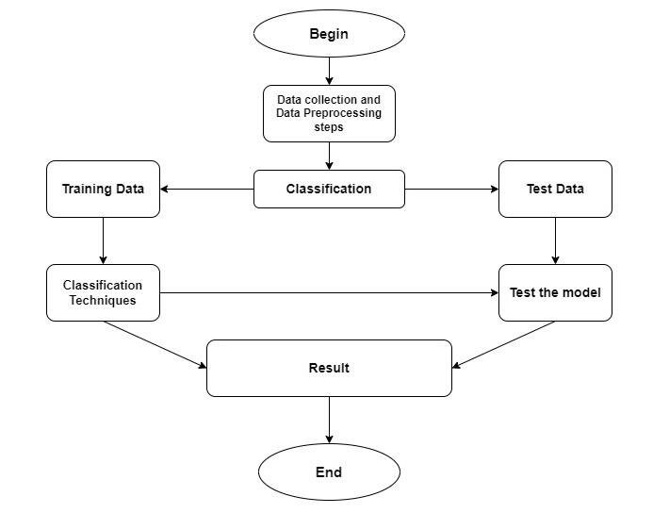
Architecture Diagram

Slide 14
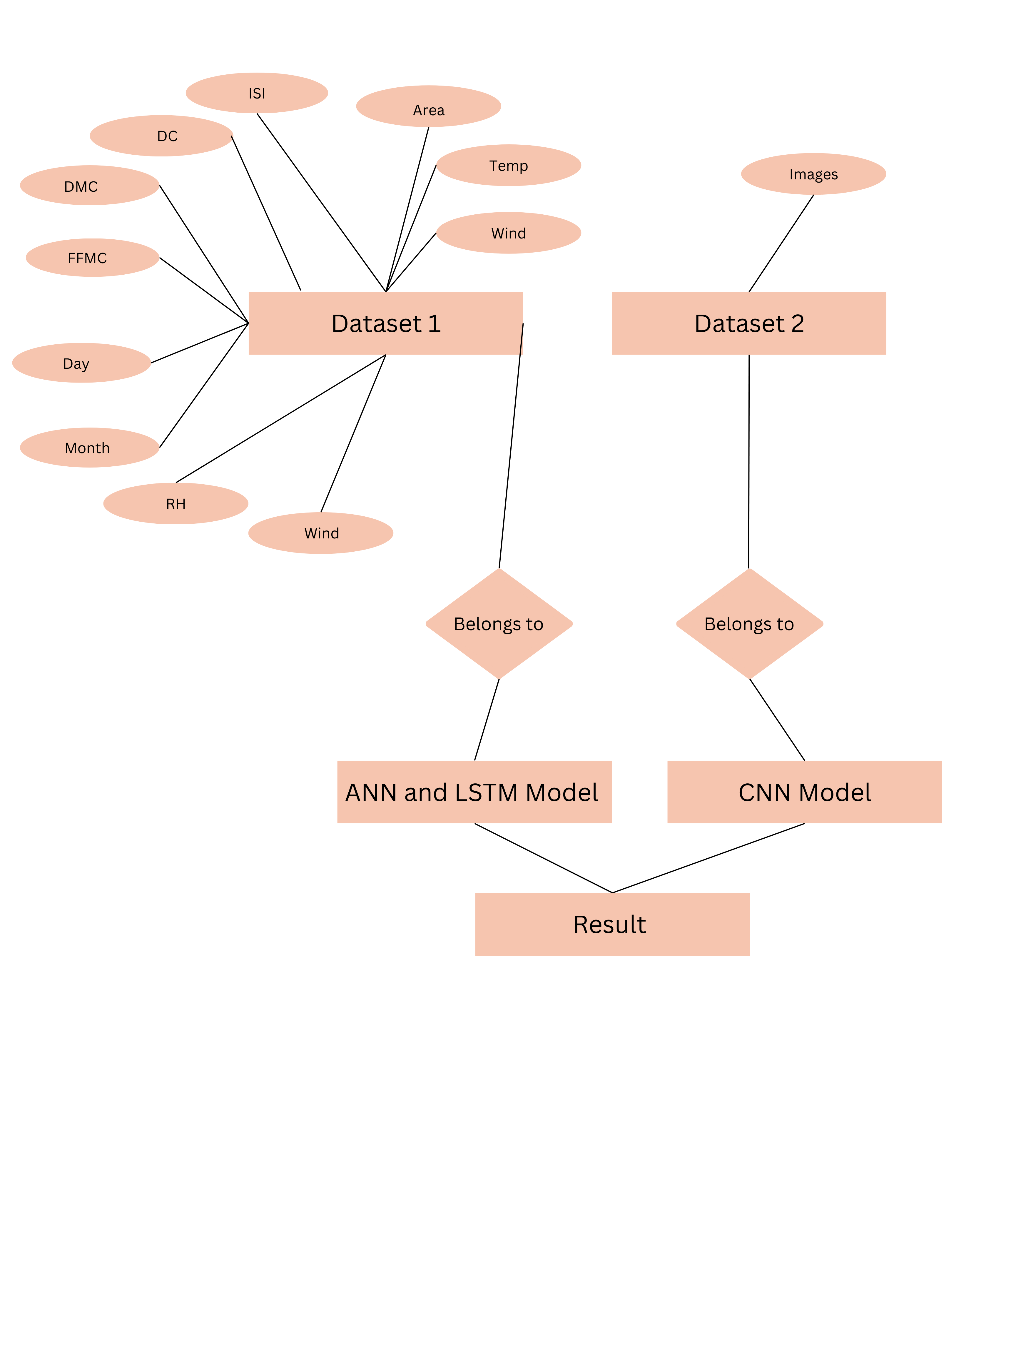
E-R Diagram

Slide 15
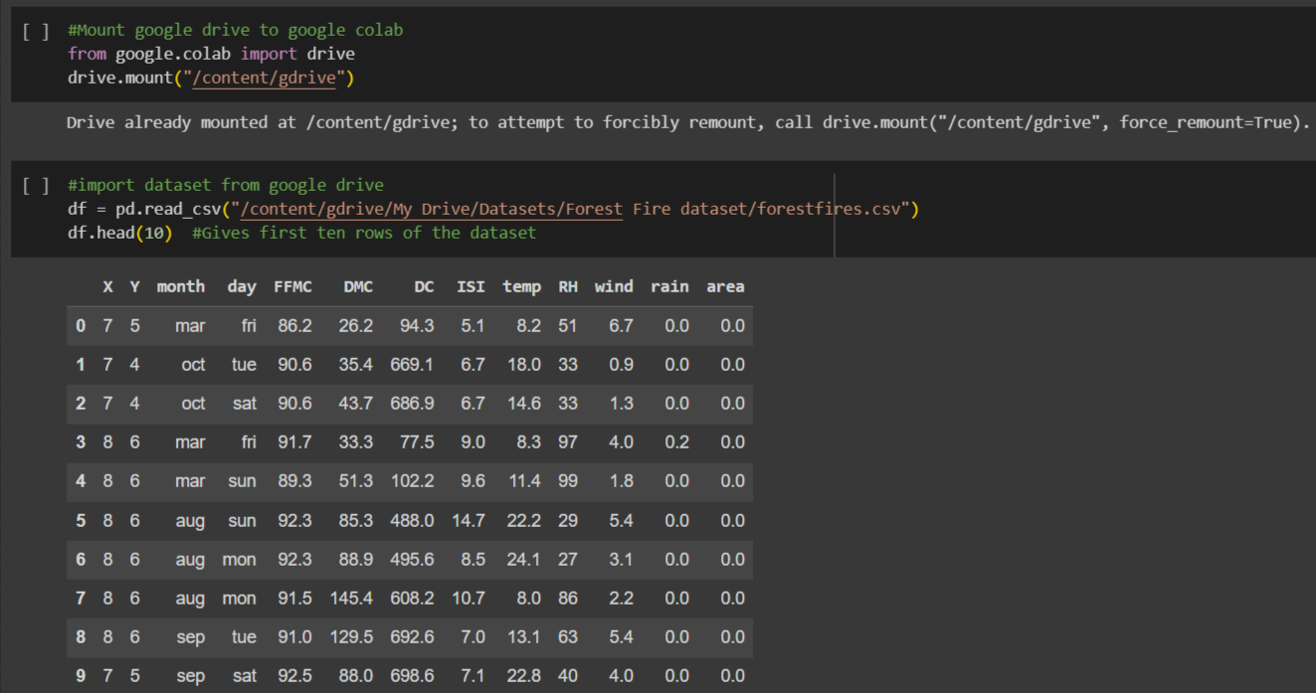
Implementation

Slide 16
Attribute Information:
X : x-axis spatial coordinate within the Montesinho park map: 1 to 9
Y : y-axis spatial coordinate within the Montesinho park map: 2 to 9
month : month of the year: ‘jan’ to ‘dec’
day : day of the week: ‘mon’ to ‘sun’
FFMC : FFMC (Fine Fuel Moisture Code) index from the FWI system: 18.7 to 96.20
DMC : DMC (Duff Moisture Code) index from the FWI system: 1.1 to 291.3
DC : DC (Drought Code) index from the FWI system: 7.9 to 860.6
ISI : ISI (Initial Spread Index) index from the FWI system: 0.0 to 56.10
temp : temperature in Celsius degrees: 2.2 to 33.30
RH : relative humidity in %: 15.0 to 100
wind : wind speed in km/h: 0.40 to 9.40
rain : outside rain in mm/m2 : 0.0 to 6.4
area : the burned area of the forest (in ha): 0.00 to 1090.84

Slide 17
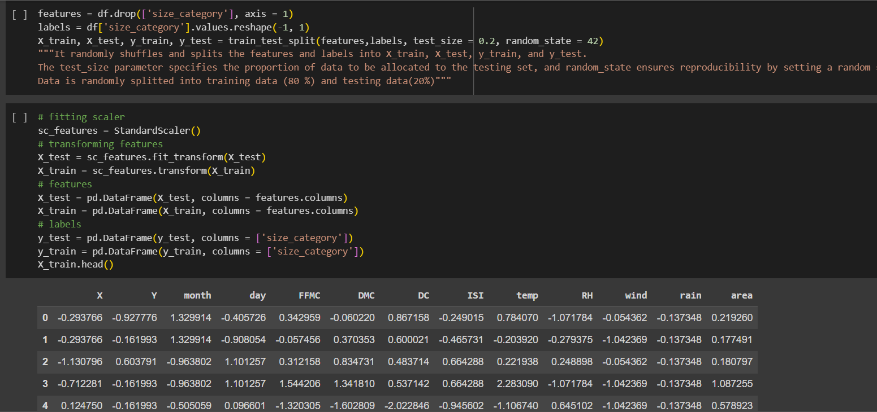
It randomly shuffles and splits the features and labels into X_train, X_test, y_train, and y_test.
Data is randomly splitted into training data (80 %) and testing data(20%)
By applying the StandardScaler, you transform your data so that it has a mean of 0 and a standard deviation of 1, which can be important for certain machine learning algorithms

Slide 18
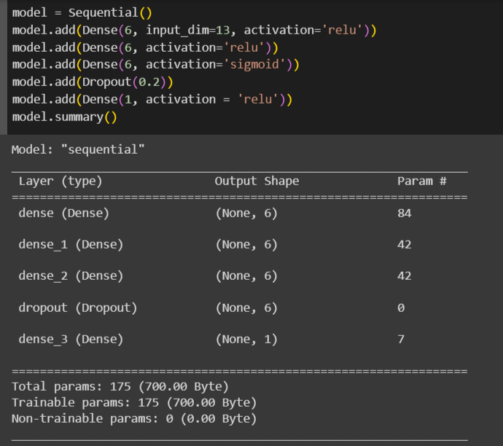
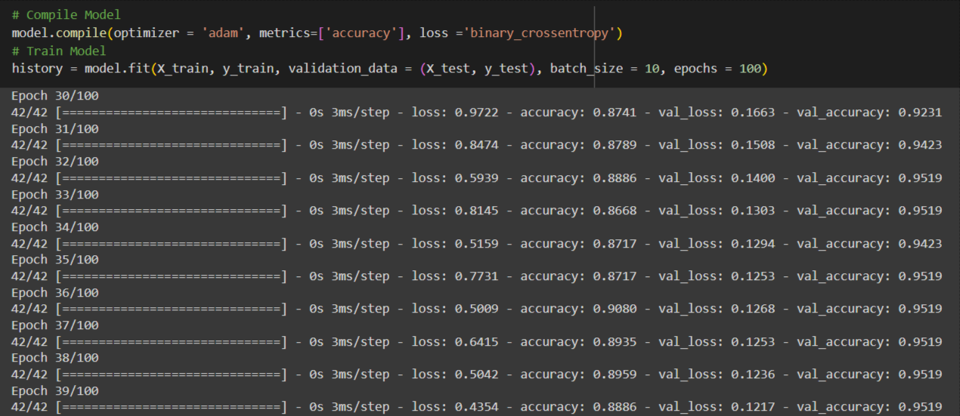
Model Architecture

Slide 19
Description
model = Sequential(): This line initializes a sequential model, which is a linear stack of layers.
model.add(Dense(6, input_dim=13, activation='relu')): This line adds the first hidden layer to the model. It has 6 units, expects input data with 13 features, and uses the ReLU activation function.
model.add(Dense(6, activation='relu')): This line adds the second hidden layer with 6 units and a ReLU activation function.
model.add(Dense(6, activation='sigmoid')): This line adds another hidden layer with 6 units and a sigmoid activation function.
model.add(Dropout(0.2)): This line adds a dropout layer with a dropout rate of 20%. Dropout is a regularization technique that helps prevent overfitting.
model.add(Dense(1, activation='relu')): This line adds the output layer with a single unit and a ReLU activation function.

Slide 20
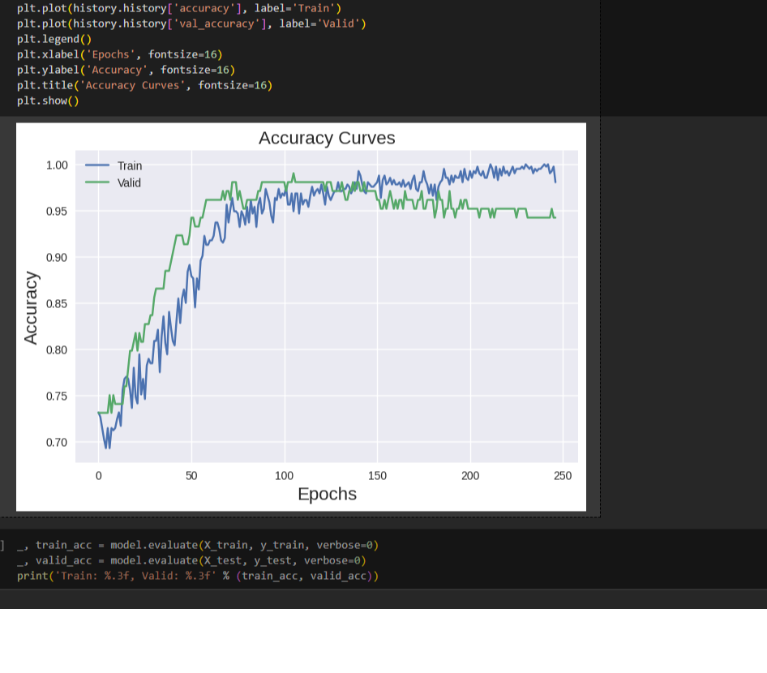
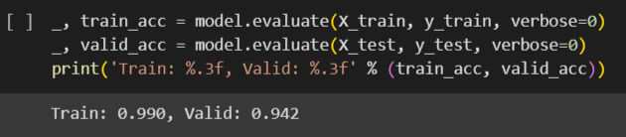
Numerical Dataset Result
model achieved a training accuracy of approximately 99.0% and a validation accuracy of approximately 94.2%.

Slide 21
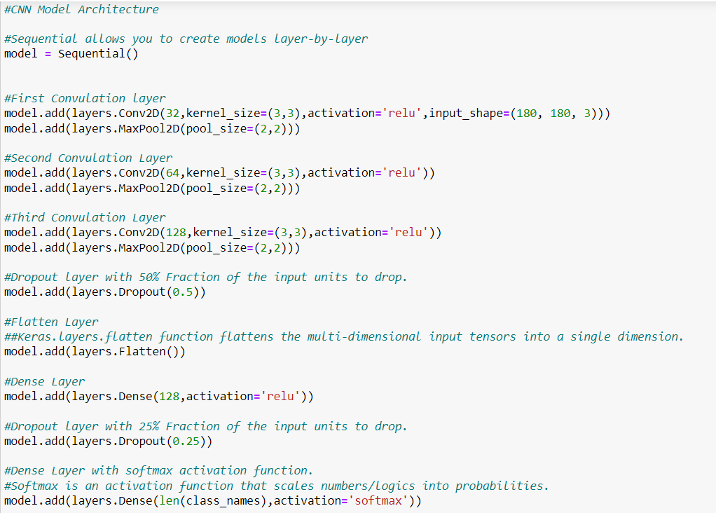
Image Dataset Result
model achieved a training accuracy of approximately 96.3% and a validation accuracy of approximately 95.3%.

Slide 22
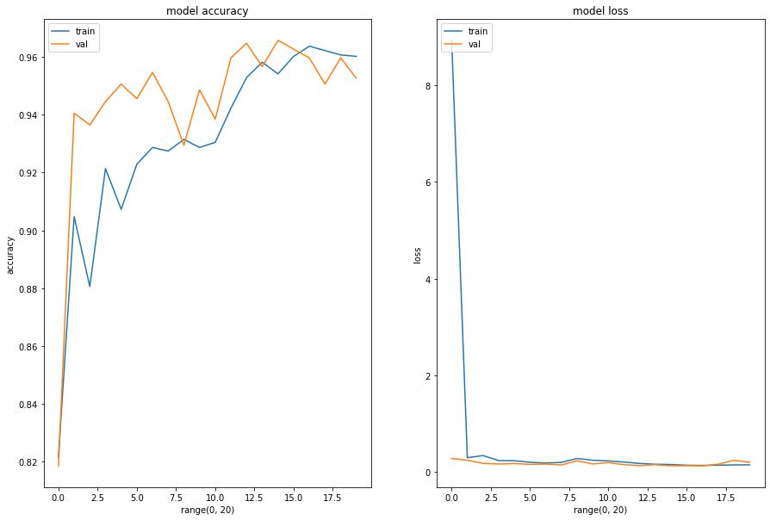
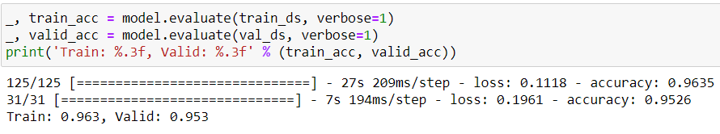

Slide 23
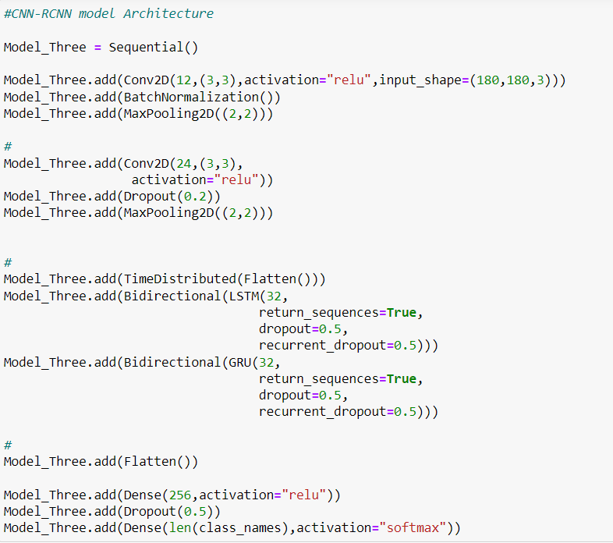

Slide 24
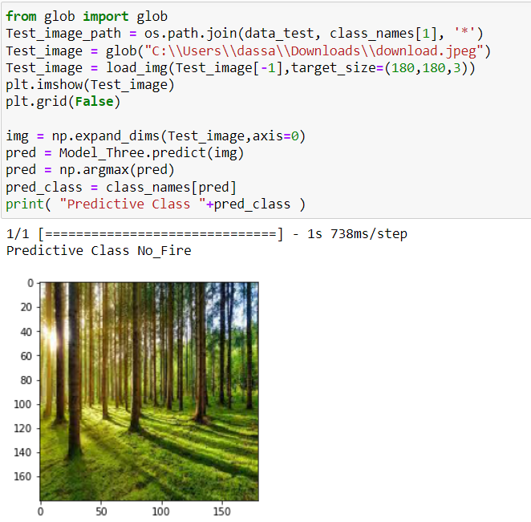
Detection

Slide 25
Conclusion
In conclusion, the Forest Fire Prediction Project demonstrates the potent synergy of deep learning in revolutionizing fire management. Leveraging diverse data, our model's convolutional and recurrent neural networks adeptly forecast spatial and temporal fire patterns, empowering timely action. With user-friendly interfaces and precise alerts, stakeholders make informed decisions, reducing risks and costs. Rigorous evaluation underscores its practical utility for saving lives, ecosystems, and resources. As we progress, embracing evolving data and technologies promises even greater advancements. Ultimately, this project paves the way for proactive fire management, exemplifying deep learning's transformative impact on safeguarding environments and communities.

Slide 26
References
IEEE Xplore - https://ieeexplore.ieee.org/document/9672446
SpringerOpen - https://fireecology.springeropen.com/articles/10.1186/s42408-022-00165-0#:~:text=These%20techniques%20detect%20fire%20by,2022).
Journals -
Chrome extension://efaidnbmnnnibpcajpcglclefindmkaj/http://www.jatit.org/volumes/Vol100No12/24Vol100No12.pdf
https://cdnsciencepub.com/doi/full/10.1139/er-2020-0019
Researchgate- https://www.researchgate.net/publication/359118440_Forest_fire_prediction_using_IoT_and_deep_learning
Scientific Research - https://www.scirp.org/journal/paperinformation.aspx?paperid=126584

Slide 27
THANK YOU

